Slide 1

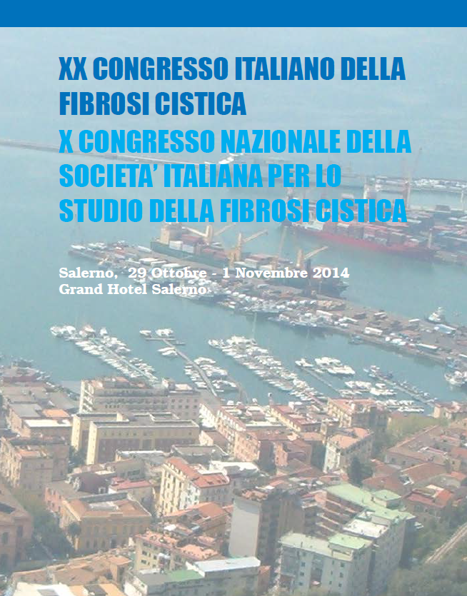



LA GESTIONE DEL TRAPIANTO IN SPAGNA
THE SPANISH MODEL OF ORGAN
DONATION AND TRANSPLANTATION
Elisabeth Coll
ORGANIZACIÓN NACIONAL DE TRASPLANTES (ONT) SPAIN

Slide 2
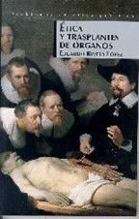
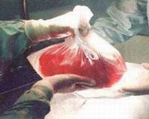
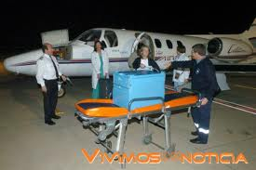
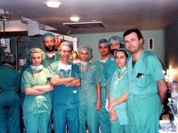


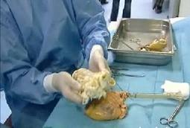


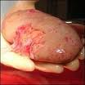
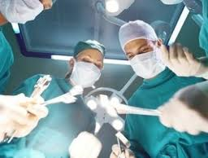
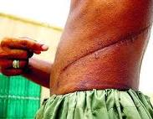
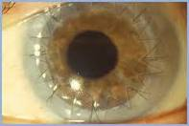
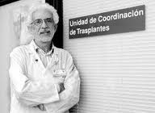
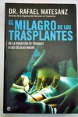
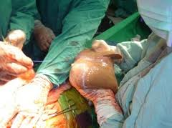
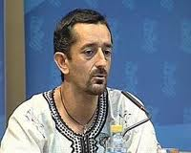
TRANSPLANTS:
A MAGNIFICIENT REALITY OF
MODERN MEDICINE

Slide 3
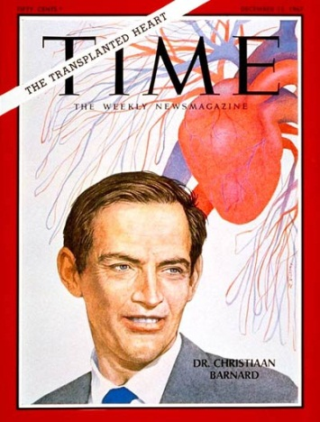
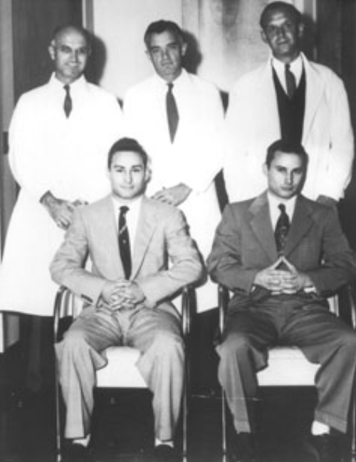
Longest survivals described for recipients of solid organs transplants
(UCLA Registry)
KIDNEY TRANSPLANT........................ >50 years
LIVER TRANSPLANT........................... >40 years
HEART TRANSPLANT......................... >30 years
PANCREAS TRANSPLANT................... >25 years
LUNG TRANSPLANT...........................>25 years
SMALL BOWEL TRANSPLANT............. >20 years
Notes:
3

Slide 4
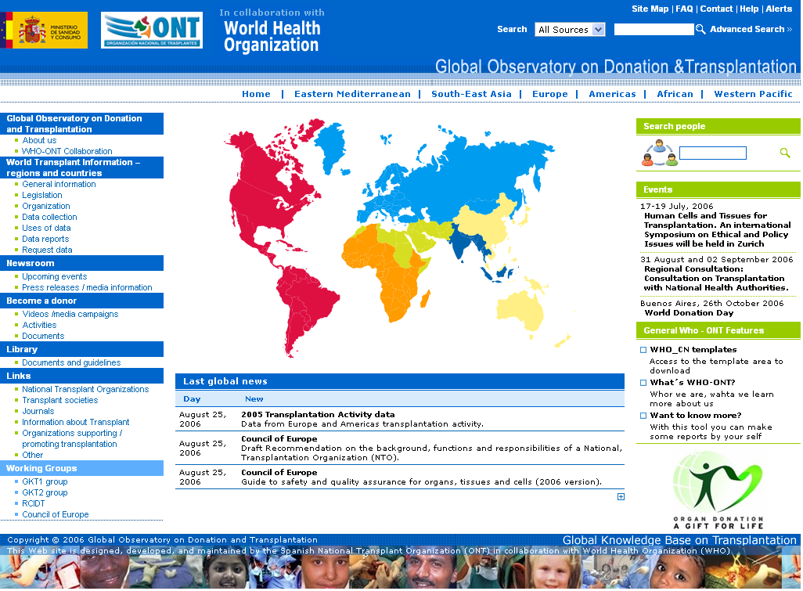



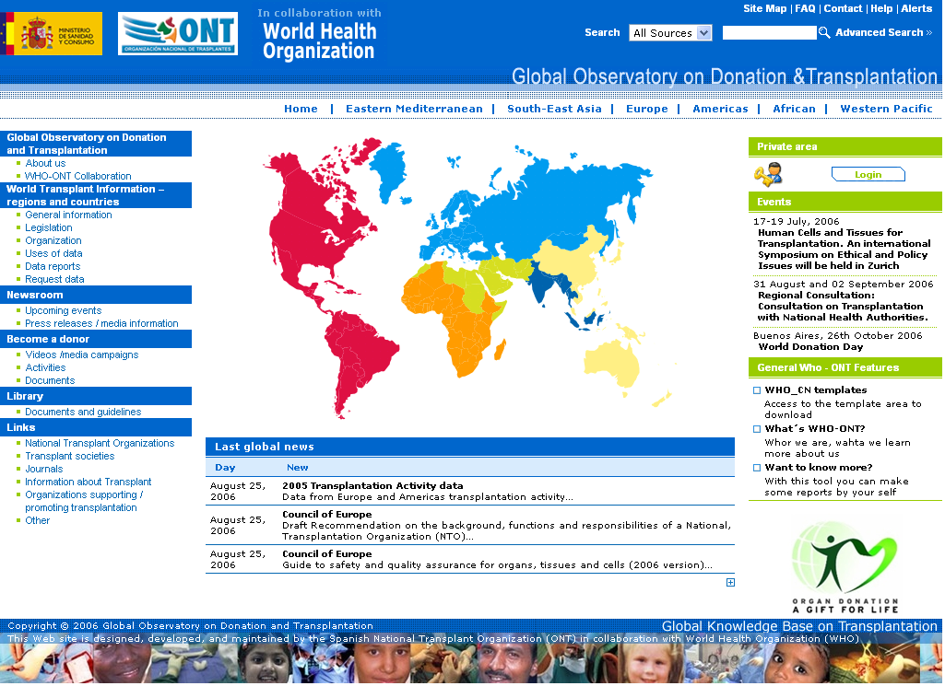
Global Activity in Organ Transplantation
2012 Estimates
GODT 2011
Kidney | Liver | Heart | Lung | Pancreas | Small bowel
77,818 | 23,986 | 5,935 | 4,359 | 2,423 | 169
≈ 114,690 solid organs reported to be transplanted in 2012
>5% increase over 2010
≤ 10% of global needs
Information of 109 Member States on organ transplantation activities is included in the GODT: 91 of 2012, 9 of 2011, 3 of 2010, 2 of 2009, 4 of 2008.

Slide 5
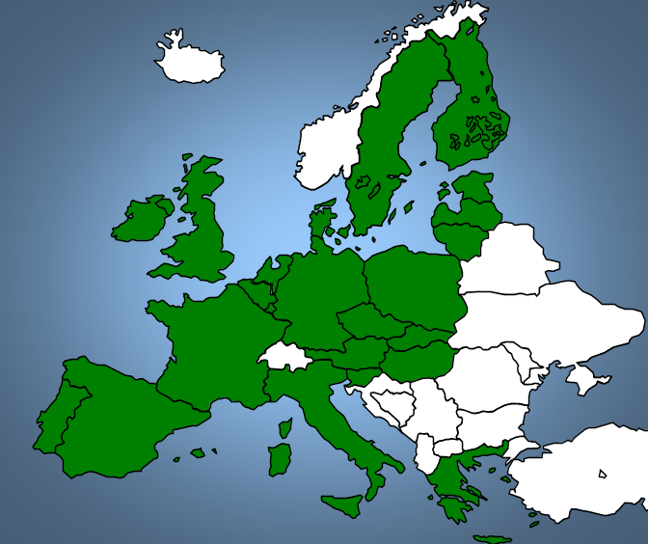

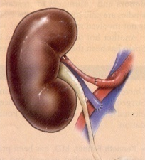
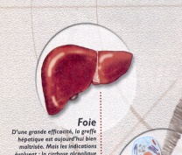

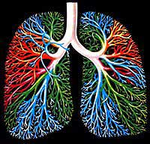
Transplant & waiting list
in the EU. 2013
(Newsletter Transplant. 2014)
TRANSPLANTS WAIT LIST*
19,227 49,317
7,173 6,652
2,037 3,447
1,825 2,095
-------------------------------------- 30,262 61,511
For many, the waiting continues … almost 4,000 patients died while waiting to be transplanted in 2013
TOTAL
*31st December candidates
Newsletter Transplant 2014 http://www.ont.es/publicaciones/Documents/NEWSLETTER2014.pdf
Notes:
5
ACTUALIZAR

Slide 6
Universal problem
ORGAN SHORTAGE
ORGAN SHORTAGE
ORGAN SHORTAGE
ORGAN SHORTAGE
ORGAN SHORTAGE

Slide 7
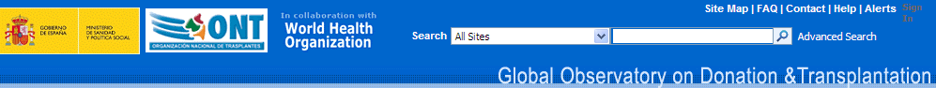
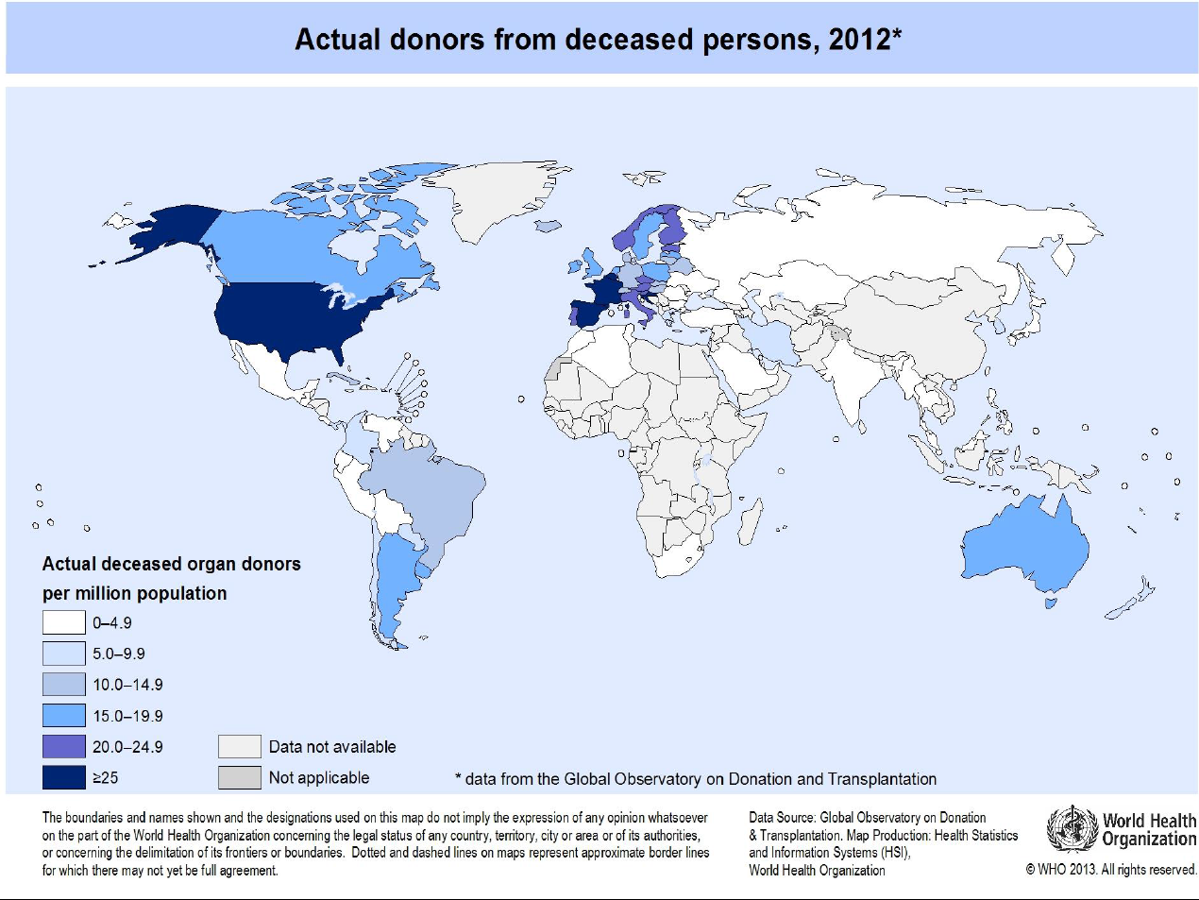

Slide 8

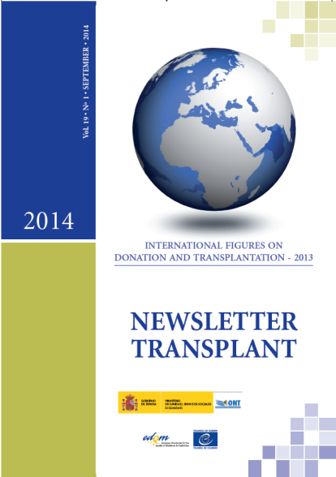
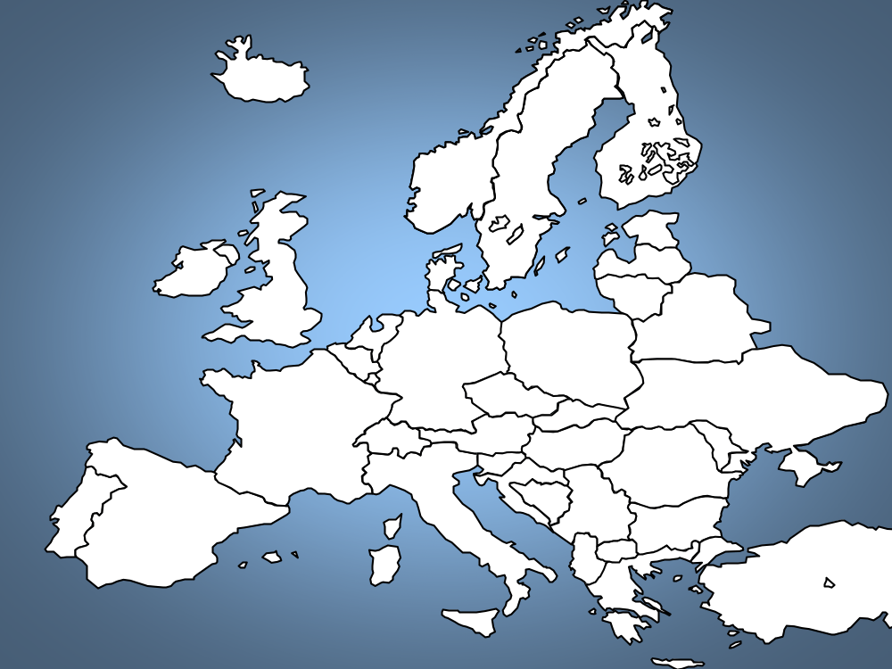

25.8
> 30 DONORS PMP
> 20 DONORS PMP
> 10 DONORS PMP
< 10 DONORS PMP
13.3
15.8
17.8
22.2
24.6
16.2
18.7
10.4
21.0
16.7
15.9
10.7
15.5
29.2
10.7
20.4
10.9
26.0
13.6
24.5
15.5
3.6
22.9
27.8
35.1
21.7
33.5
5.1
5.6
ORGAN DONORS 2013
EU 19.5 pmp
35.0
5.5
Notes:
ACTUALIZAR

Slide 9

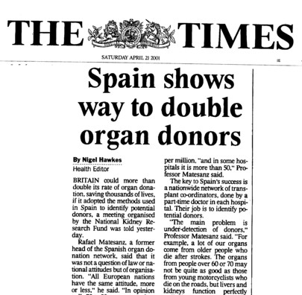
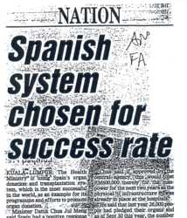
Deceased organ donors in Spain. 1989-2013
Notes:
Let´s take over the Spanish system. a model in which the government by taking over its responsibility on self-sufficiency has been able to develop an extraordinarily effecftive system.

Slide 10
Organ Transplants in Spain 1989-2013
1300
Transplants
4278

Slide 11
Lung Transplants in Spain 1993-2013
10-15% CYSTIC FIBROSIS
20
Lung Transplants
285
Notes:
6,1 pmp en 2013 (italia 2,3, media UE 3,6)

Slide 12
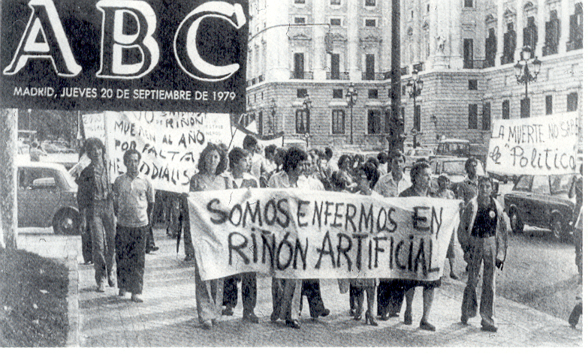
During the eighties…
… things were not that easy

Slide 13



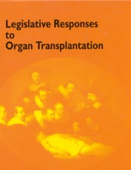
“Classical measures” to improve donation
Legislative changes
Promotional campaigns
Donor registries
Donor cards
Driving licenses
Other ways of promotion

Slide 14
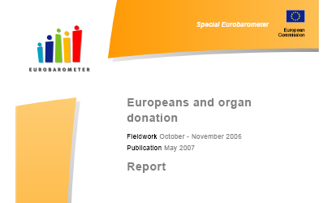
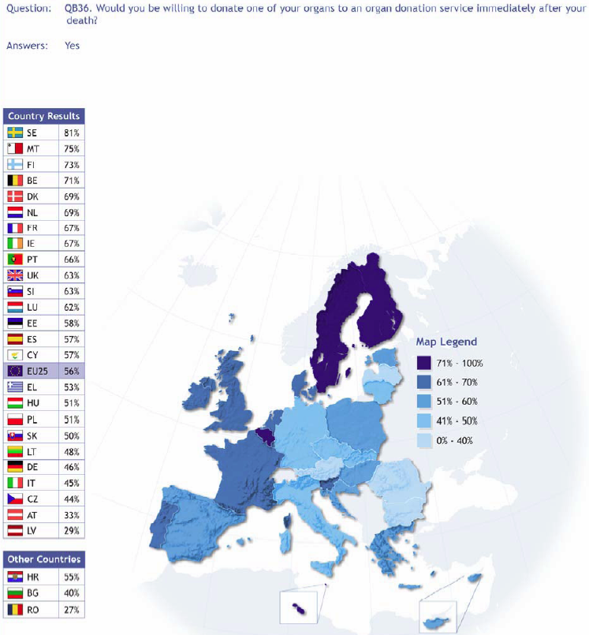
WOULD YOU DONATE YOUR ORGANS AFTER DEATH?

Slide 15

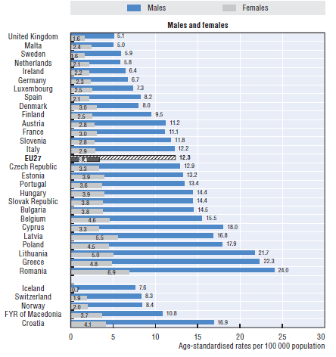
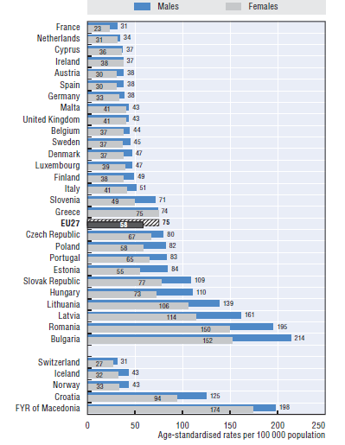
Mortality rates relevant for organ donation in Europe
Transport accidents. 2010
Stroke. 2010
http://ec.europa.eu/health/reports/docs/health_glance_2012_en.pdf

Slide 16
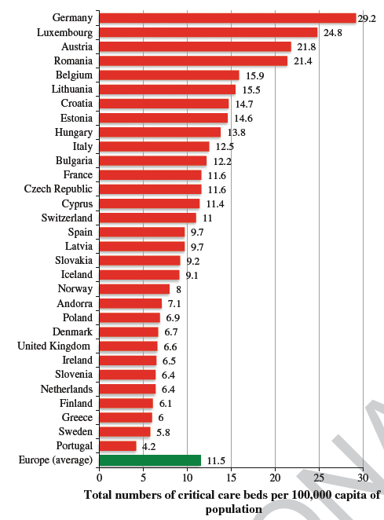
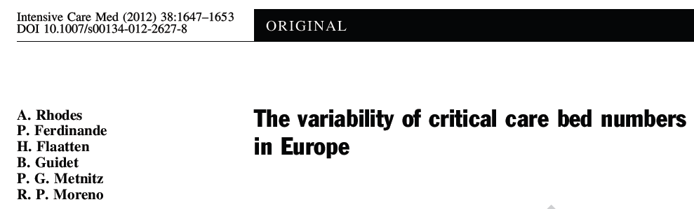
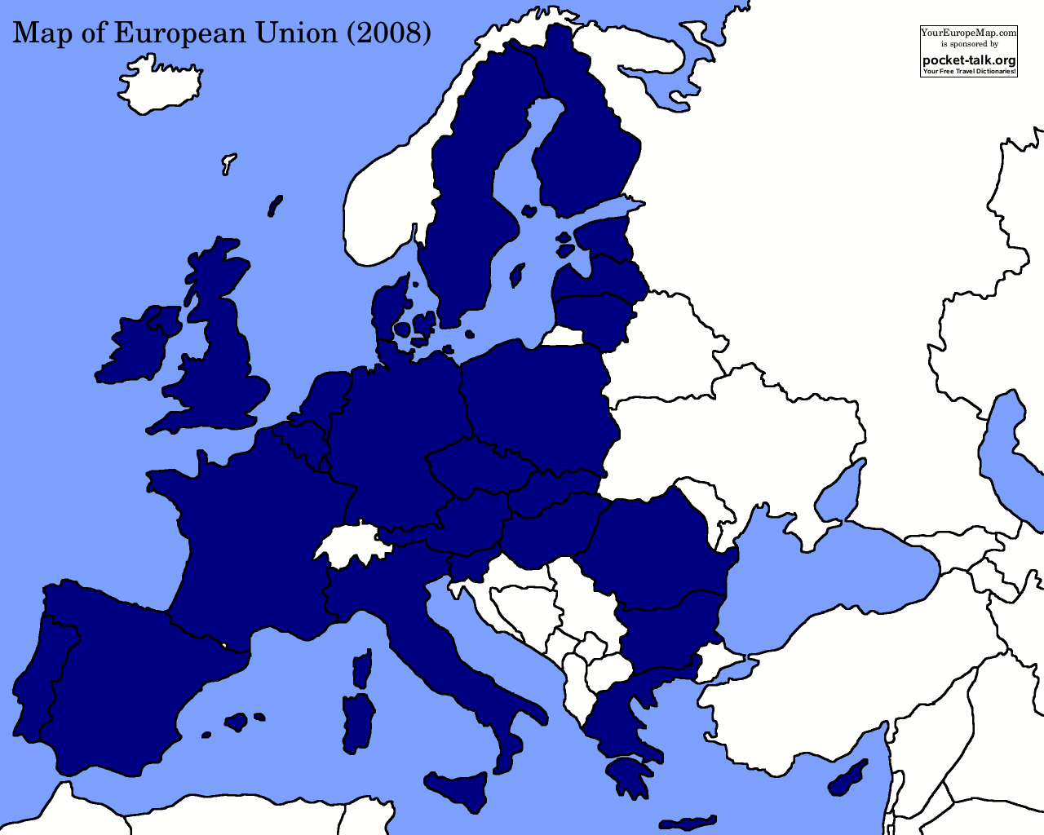
Notes:
And so clinicians in the UK had a reason to justifiy limiting or restricting access to critical care.
And they also had a pressing need as the relative availability of ICU beds in the UK began to fall well short of those in other countries

Slide 17
Philosophy of the Spanish Model
IMPROVEMENTS
IN DONATION
IMPROVEMENTS
IN ORGANIZATION

Slide 18
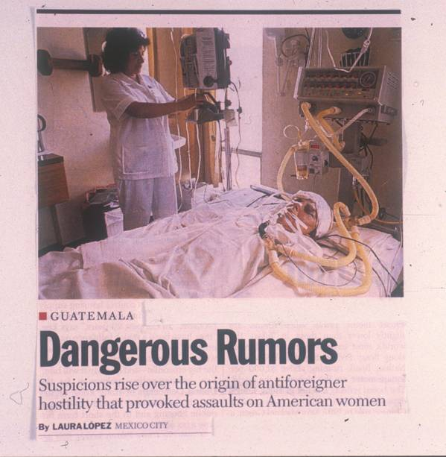
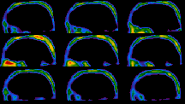
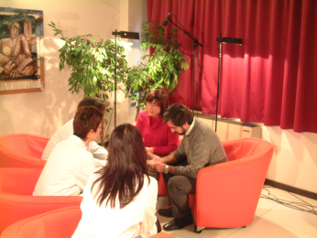
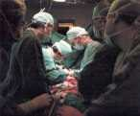
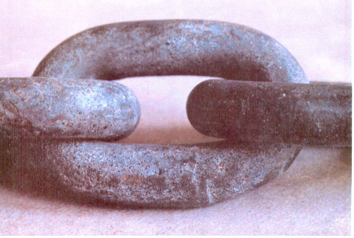

The process of deceased donation
DONOR DETECTION
DONOR MAINTENANCE
P
R
O
C
U
R
E
M
E
N
T
BRAIN DEATH DIAGNOSIS
FAMILY AND LEGAL CONSENT
TRANSPLANTS
LOCAL AND ORGANISATIONAL FACTORS
Notes:
18
In the process of organ donation and transplantation. the two main points of improvement are donor detection and the family consent

Slide 19

Basic principles of the Spanish Model
Adequate legal and technical background
--------------------------------------------------------------
Transplant coordination network
Special profile of the three levels of TC
Hospital coordinators inside the hospitals
Central Office: ONT - Support Agency
Continuous brain death audit
Great effort in medical training
Much attention to the mass media
Hospital reimbursement
All these points together !!!

Slide 20
Spanish health-care
Technical and political reality
Health care system: Universal coverage
Technical background: Experienced and innovative transplant teams
Political framework: Decentralized system (17 autonomous regions)

Slide 21

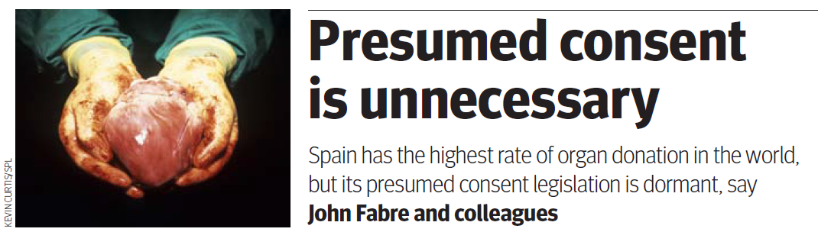
Spanish Legal Framework
Transplant Law 1979. RD 1723/2012
Death Certification
Consent: Presumed consent just theoretical, not in practice
Criteria for living and deceased donation
Criteria for authorization/accreditation of procurement and transplant centers
Need of traceability
Control of Import/export
Organization of the Coordination system
Non profit; Publicity
Fabre et al. British Medical Journal 2010

Slide 22
1
Transplant coordination network
REGIONAL
H
R
R
H
R
H
NATIONAL
R
H
HOSPITAL
Notes:
Transplant coordination in Spain has been organized at three different but related levels: hospital. regional and national. each of these levels with their own and specific responsibilities in the process of organ donation.
The national level of the network. the ONT. is a central office in Madrid. which supports the whole process of donation. not acting solely as a sharing office. Along with the regional organizations. the ONT also acts as a real interface between the hospital and the political level and both are nominated and paid by the Regional and National authorities. respectively. Outstandingly. every technical decision is taken as a consensus by a commission constituted by the ONT and the responsible of every one of the regional offices.
The third level of the transplant coordination network is represented by the hospital coordinators. who are directly involved in the process of donation. developing a proactive program on donor detection. and being in charge of donor evaluation and maintenance. family and judicial approach if needed. as well as coordination of all the process of organ procurement.

Slide 23
Number of hospital transplant coordination teams
185
118
56
< 20
1988 1990
1992 2013
Notes:
The number of hospitals integrating the transplant procurement network seems to have a direct impact on the number of deceased organ donors. As a matter of fact. along the last years. the number of transplant procurement hospitals has progressively increased in our country. from less than 20 units in 1988 to 185 units in the year 2013.

Slide 24

2
Coordinator profile
Medical doctors +/- nurses
Part time dedicated
ICU +/- nephrologists...
In-hospital
Dependency: medical director
Main objective: Organ donation
More and more involved in:
  Resources management
  Mass media
  Logistic support of the process
  Training
  Research
Notes:
The figure of the transplant coordinator is considered for many as the one that is able to establish the difference between a successful and a not successful program on deceased donation. The main responsibility of this figure (also referred to as key donation person) is represented by a proactive donor detection program.
The profile of the hospital transplant coordinator in Spain is probably one of the most important differences when comparing the organisational and structural system on transplantation among the European countries.
Transplant coordinators are mainly physicians. supported by nurses in those hospitals with a quantitatively important donation activity. The medical specialty of the transplant coordinator in Spain has necessarily evolved in the last years; in fact. while most of the coordinators were nephrologists in the eighties. the majority of them are intensive care unit specialists at the present moment.
Except for a few cases. the figure of the coordinator is part-time dedicated to the transplant coordination activities. This characteristic allows the possibility of having a transplant coordinator appointed even in small hospitals. While having a close relation to the transplant teams. the figure of the transplant coordinator in Spain does not depend. neither report to the transplant team. The transplant coordinator is in fact nominated by and must report to the hospital direction. although is functionally linked to the regional and the national transplant organization.

Slide 25
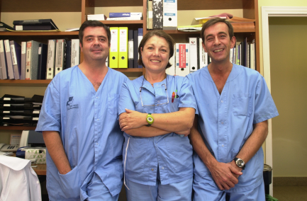
Coordination teams
Spain 2013 (N =185)
Medical personnel = 243
Part time dedication = 95.5 %
Full time dedication= 4.5 %
Nursing personnel = 139
Part time dedication = 70 %
Full time dedication = 30 %

Slide 26

National Oversight Agency: ONT
3
Wait list management
Organ allocation
Logistic support to the deceased donation process
National registries, research
National programs- Quality Assurance Program
Promotion & education on donation & transplantation
Training programs
Media relation
Legislation
International cooperation

Slide 27
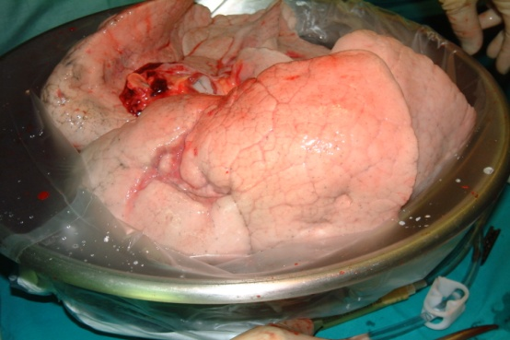
ALLOCATION CRITERIA
GENERAL
GEOGRAPHICAL CRITERIA
ORGAN
ALLOCATION
HOSPITAL
CITY
REGION
ZONE
NATIONAL
EUROPE

Slide 28
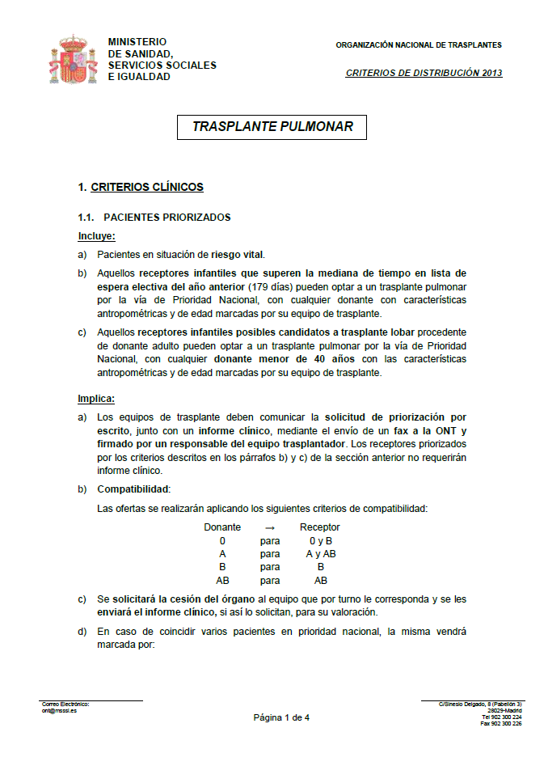
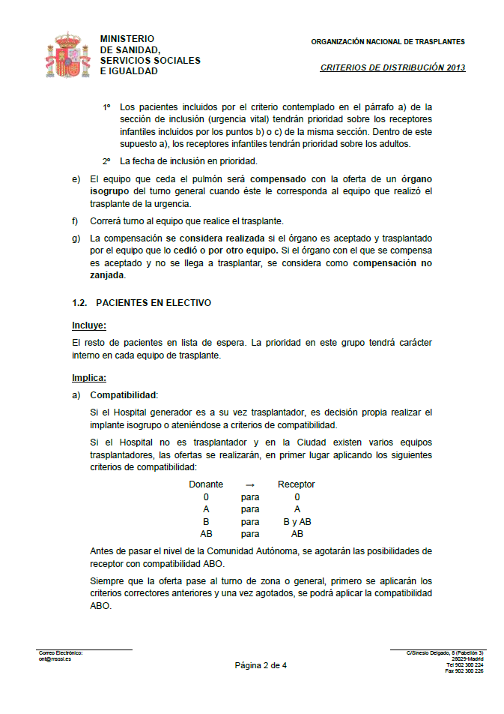
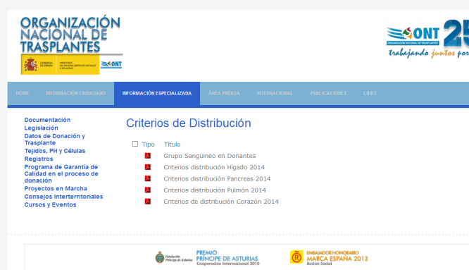
ALLOCATION CRITERIA
LUNG TRANSPLANTATION
CLINICAL CRITERIA
ABO COMPATIBILITY
NATIONAL PRIORITY
Risk to life
Children > 6 months waiting list
ELECTIVE PATIENTS
Geographical Criteria
Priority decided internally for every transplantation team
  Donor characteristics-suitability
  Severity
  Time on waiting list
http://www.ont.es/infesp/Paginas/CriteriosdeDistribucion.aspx

Slide 29

4
Quality Assurance Program in
Deceased Donation
POTENTIAL DONORS (PD)*: 28,056 (12.4%)
Internal evaluation (1999-2011)
PD not identified - referred: 0.9%
118 EXTERNAL EVALUATIONS
IN THE SAME PERIOD
Medical unsuitability: 22.7%
Organ recovery does not proceed:
Brain death diagnosis not completed: 0.1%
Maintenance problems: 2.8%
Consent declined: 12.3%
Coroner refusal: 0.3%
Logistic problems: 0.4%
Lack of appropriate recipient: 0.7%
* Clinical Condition consistent with brain death
ACTUAL DONORS: 15,556 (55.4% of PD)

Slide 30
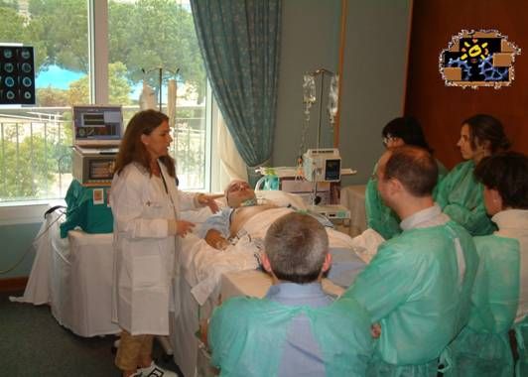

5
Great effort in training
Courses to train Donor Transplant Coordinators
Courses targeted to residents in Critical Care Medicine
Courses targeted to Urgency and Emergency personnel
Courses targeted to Neurologists – Stroke Units
Courses to communicate in critical situations
MORE THAN 15,000 HEALTH CARE PROFESSIONALS HAVE BEEN TRAINED THROUGH ONT COURSES SINCE 1991

