Slide 1
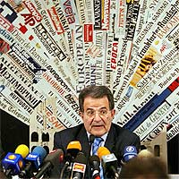
6
Close atention to the media
24 hours telephone (public. professionals & media)
Media have easy and permanent access
Connection with journalists
Messages transmitted with no intermediaries
Notes:
With the aim of improving the level of knowledge on donation and transplantation of the population. close attention to the media has been dedicated.
A 24 hour telephone hotline and an updated web site are available for consultation. questions and answers. The transplant hotline. originally intended for the public. has become popular among health care professionals. especially general practitioners. and the media. The fact that anyone. including the media. can. at any time. obtain medical. legal or statistical information about organ donation. has helped reduce the incidence of adverse stories about transplantation. increase public confidence and help to generate a climate of trust and transparency about organ transplantation.
Besides. transplant coordinators receive specific training courses on communication with the media. Controversial issues as organ trafficking and brain death are deeply discussed at these forums. Meeting with journalists are periodically held in a proactive fashion or under specific requests. Specific meetings attended by journalists and opinion leaders on transplantation issues have been performed in a yearly basis.
Outstandingly. a quick and efficient management of adverse publicity and other critical situations have also helped to generate a positive thinking on donation and transplantation among the Spanish population.

Slide 2
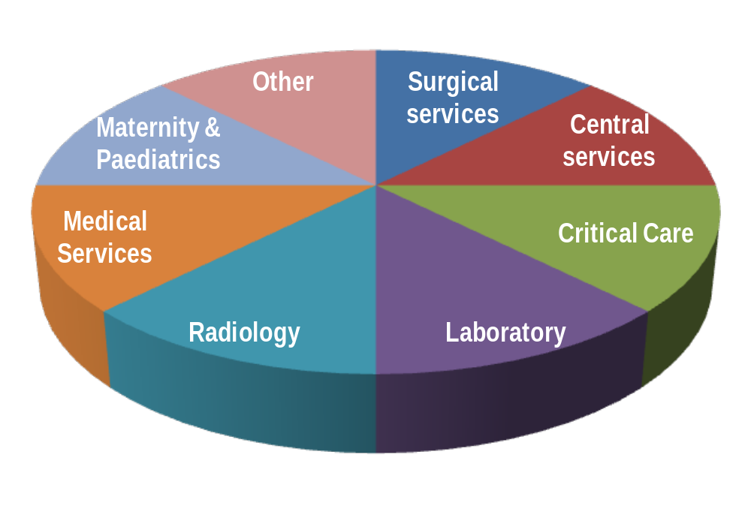



7
Hospital Reimbursement
Deceased donation & transplantation is considered part of the hospital activities & is appropriately resourced
Cuidados
Críticos
Notes:
As any other medical activity performed at the public health care system. the donation and transplantation activities in Spain are properly reimbursed by the regional health care authorities. Each procurement and transplantation hospital is budgeted yearly according to the donation and transplantation activities performed in the previous year. Reimbursement covers all human and material resources needed to efficiently develop the donation and transplantation program within the hospital. Without a proper financial coverage. it is impossible for a hospital to efficiently maintain a program of deceased donation. especially for those small. non-university hospitals. without transplantation facilities. In general terms. organ donation should never be a disincentive activity.

Slide 3
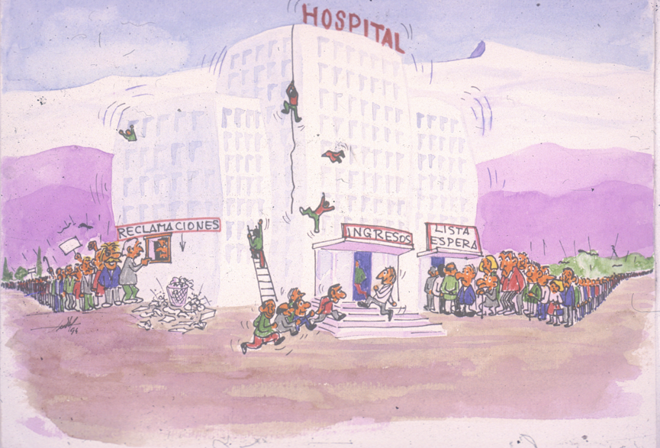
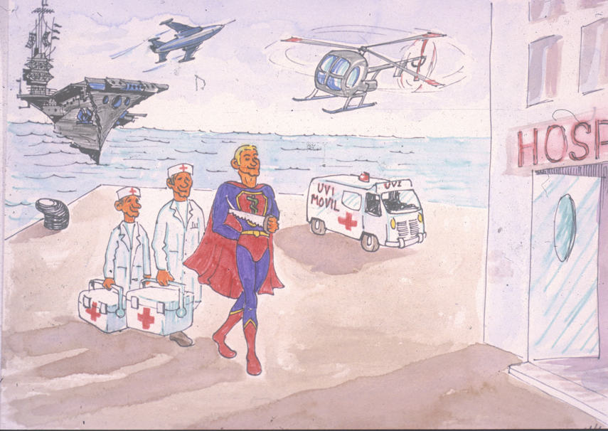
CRISIS
LUXURY?

Slide 4
Estimated cost of donation & transplantation activities in Spain
Thanks to renal transplants, we save every year twice the cost of all procurement and transplantation activities performed in Spain
 | UNIT | TOTAL
ORGAN PROCUREMENT |  | 10.771.084 €
RENAL TRANSPLANTS | 27.651 | 60.832.200 €
LIVER TRANSPLANTS | 55.900 | 59.813.000 €
HEART TRANSPLANTS | 52.999 | 15.210.713 €
LUNG TRANSPLANTS | 61.850 | 10.328.950 €
PANCREATIC TRANSPL. | 46.407 | 4.455.072 €
PERIPHERIC STRUCTURE OF COORDINATION |  | 5.186.747 €
NATIONAL STRUCTURE OF COORDINATION |  | 4.000.000 €
TOTAL |  | 170.597.766 €
22.000 patients x 21.000 € annual savings= 462.000.000 € total savings
3.0 %
2.3 %

Slide 5

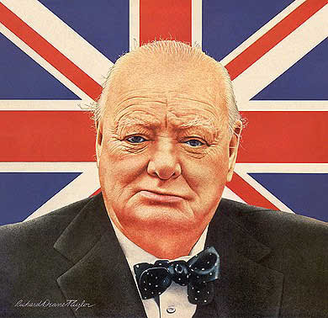
Innovation
‘To improve is to change;
to be perfect is to change often’
WinstonChurchill

Slide 6
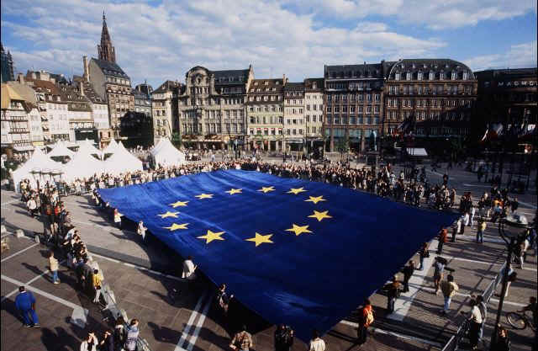
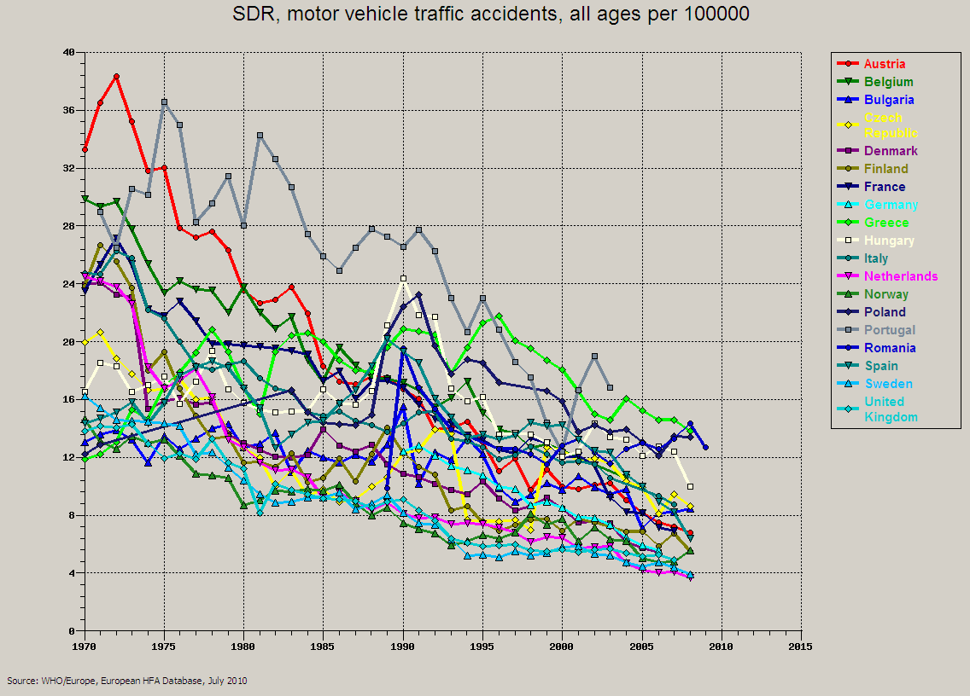
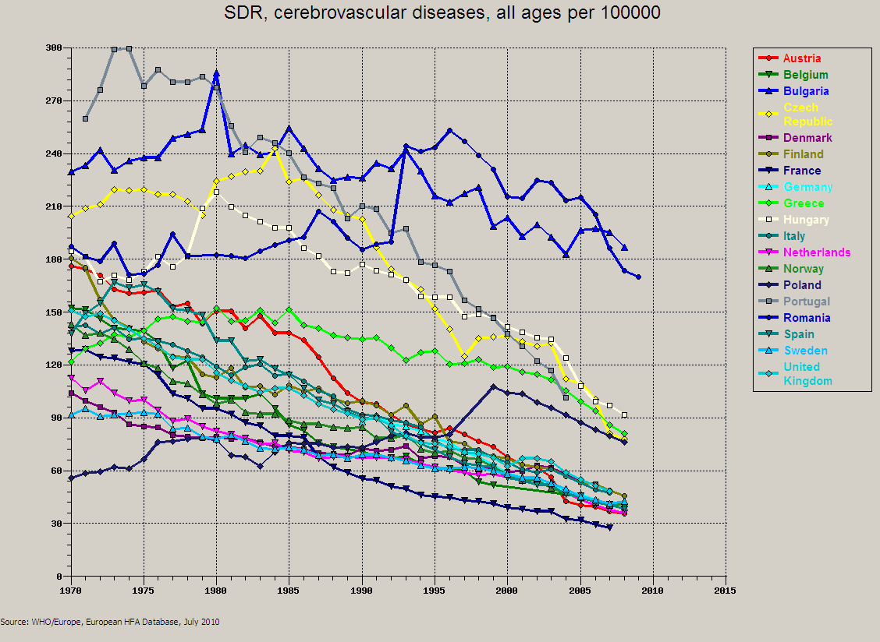
Decrease of
mortality relevant for organ donation
in most of the EU countries
SDR. motor vehicle accidents. all ages per 100.000
SDR. cerebrovascular diseases all ages per 100.000
Notes:
And this is not just a Spanish situation. These are data from WHO where you can see the decrease of mortality relevant for organ donation: road traffic accidents and cerebrovascular diseases in most European countries. although with differences between eastern and western countries.

Slide 7

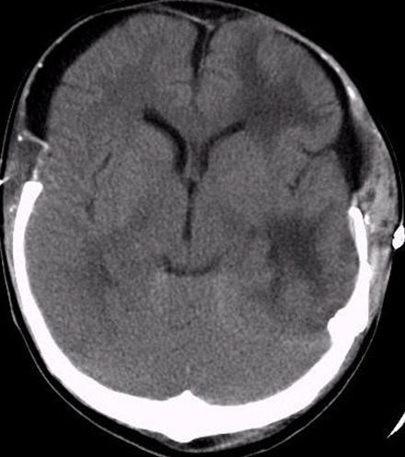
Progressive decline in the potential of donation after brain death in Spain
ESSENTIAL TO OPTIMIZE PERFORMANCE IN THE PROCESS OF DONATION AFTER BRAIN DEATH AND TO LOOK FOR ALTERNATIVE SOURCES OF ORGANS FOR TRANSPLANTATION
De la Rosa G. Domínguez-Gil. et al. Am J Transplant 2012; 12:2507
Notes:
Limitar a 2009

Slide 8
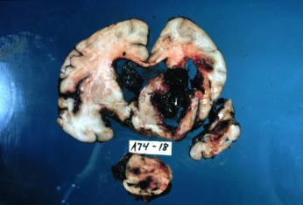
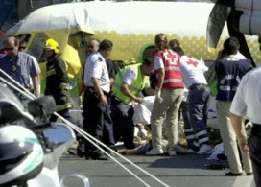
Cause of death of deceased donors in Spain
ROAD TRAFFIC ACCIDENTS 2013: 4%

Slide 9
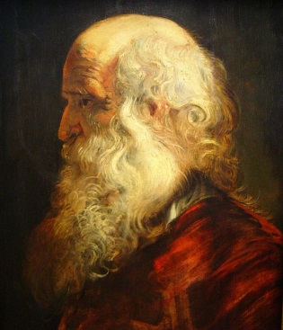
Age groups of deceased donors in Spain
EVOLUTION
OF THE AGE
OF DONORS
IN SPAIN.

Slide 10
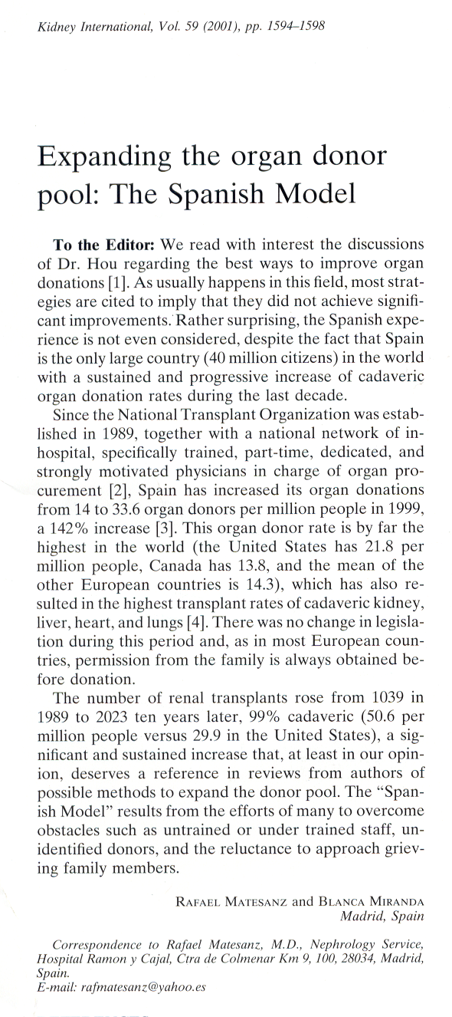

EXPANSION DONOR POOL
40 pmp DONOR PLAN
OBJECTIVE: Donor rate 40 pmp
  DBD Optimization
  DCD
  Living Donation
  Expanded criteria/ NSR donors
  Special Surgical Techniques

Slide 11

Benchmarking in organ donation
Brain Death optimization
Living donation
Transmissible diseases
- Neoplasias
Infections
Donation in minorities
Donor Pool
Other pathologies:
HTA. DM
Intoxications
Rare diseases…
Donation after circulatory death
Old donors
Special surgical techniques (liver split and domino. double kidney)
Expanded criteria
Non standard risk donors

Slide 12
Benchmarking project in the donation process
Benchmarking in organ donation
Optimize the process of donation after brain death
Search, identification and spread of the best practices in the process of donation after brain death
Application of the benchmarking methodology to the process of donation after brain death

Slide 13
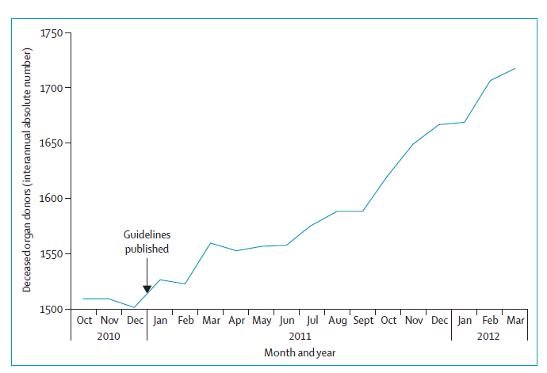
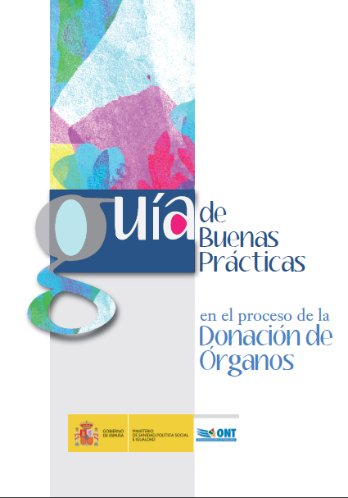




Benchmarking in organ donation
Monthly evolution of the interannual number of deceased organ donors in Spain
GOOD PRACTICES GUIDELINE
AVAILABLE IN SPANISH, ENGLISH, GERMAN AND ITALIAN
http://www.ont.es/publicaciones/Paginas/Publicaciones.aspx
Number of donors within the 12 previous months at a given date
Matesanz R et al. Lancet 2012

Slide 14
Brain Death optimization
Living donation
Transmissible diseases
- Neoplasias
Infections
Donation in minorities
Donor Pool
Other pathologies:
HTA. DM
Intoxications
Rare diseases…
Donation after circulatory death
Old donors
Special surgical techniques (liver split and domino. double kidney)
Expanded criteria
Non standard risk donors

Slide 15
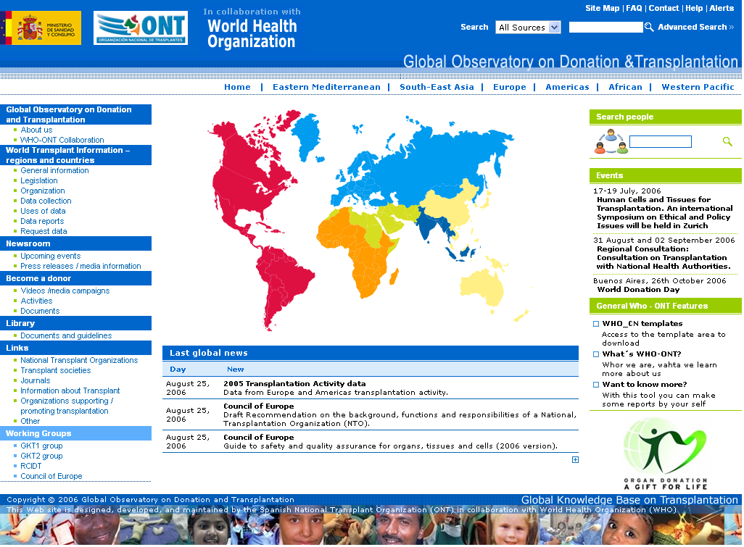
DCD DONATION IN THE WORLD
Absolute numbers (pmp) Year 2011
Russia: 187 (1.3)
Canada: 65 (1.9)
Corea Rep. : 4 (0.1)*
United States of America: 1055 (3.4)
Japan: 81 (0.6)*
>3 pmp
1-3 pmp
< 1pmp
Singapur: 2 (0.4)
Australia: 86 (3.8)
*2010 Dato
New Zeland: 2 (0.5)

Slide 16
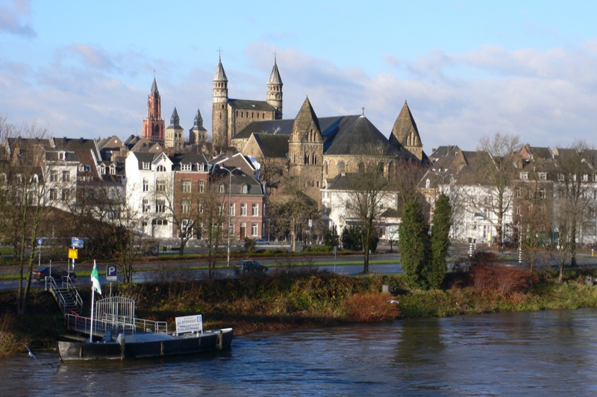
1er International Workshop
Donors after
circulatory death (DCD)
(Maastricht 1995)
I | Dead on arrival
II | Unsuccessful resuscitation
III | Awaiting cardiac arrest
IV | Cardiac arrest after brain death
NON CONTROLLED
CONTROLLED
^{Kootstra G.} ^{Transplant Proc 1995; 27: 2983}

Slide 17
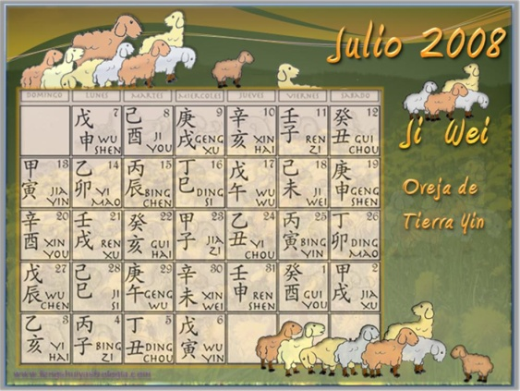


Donation after Circulatory Death
Spanish programme to promote DCD
AIMS
Creation of new DCD programs – uDCD & cDCD
Increase the effectiveness of existing programs- utilization rate and number of organs recovered
& transplanted per donor
Evaluate postransplant outcomes with organs from DCD-
strategies for improvement
CONSOLIDATION
NETWORKING
BENCHMARKING

Slide 18
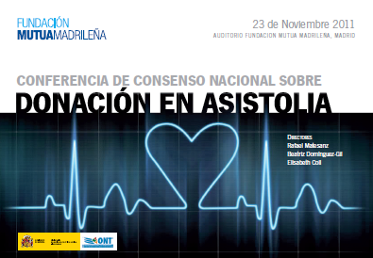
Donation after Circulatory Death
Introduction
Glossary & classification of DCD
Determination of death by circulatory criteria
Uncontrolled DCD
  Out-of-hospital logistics. Donor selection criteria
  In-hospital logistics. Donor selection criteria
  Preservation. recovery and organ viability
  Family approach
Controlled DCD
  Donor selection criteria
  WLST
  Family approach
  Extubation. cardiac arrest and death determination
  Preservation. recovery and organ viability
  Requisites for starting a controlled DCD program
Recipient selection criteria & peritransplant management. Information to the potential recipient
Communication with the media
Ethical & legal aspects
DCD in Spain: state of the art and recommendations
National Consensus
Document 2012

Slide 19
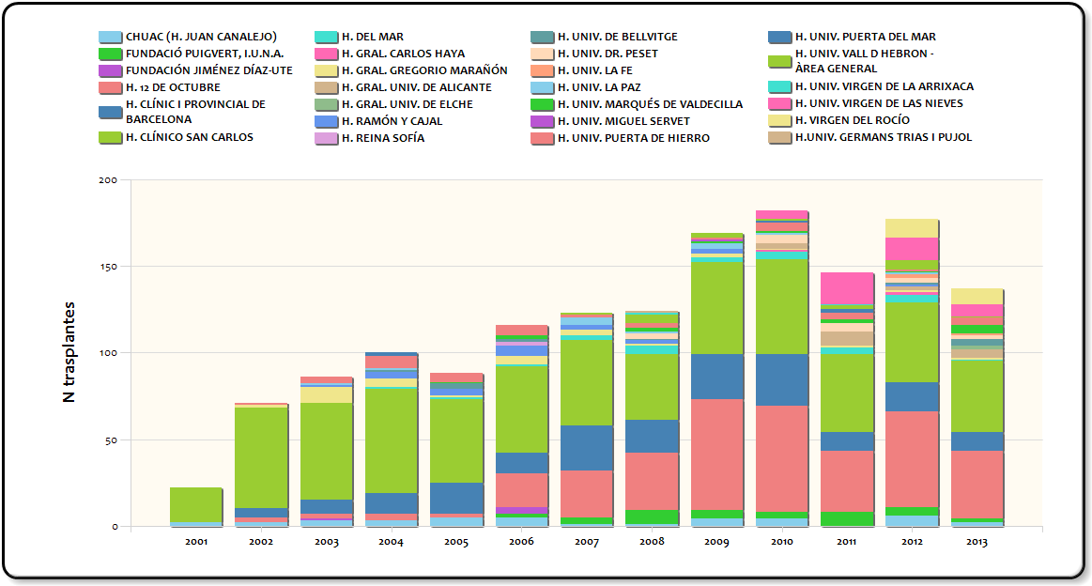
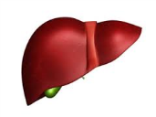


TRANSPLANTS
TYPE II MAASTRICHT DCD
1343 KIDNEY TX
131 LIVER TX
66 LUNG TX

Slide 20
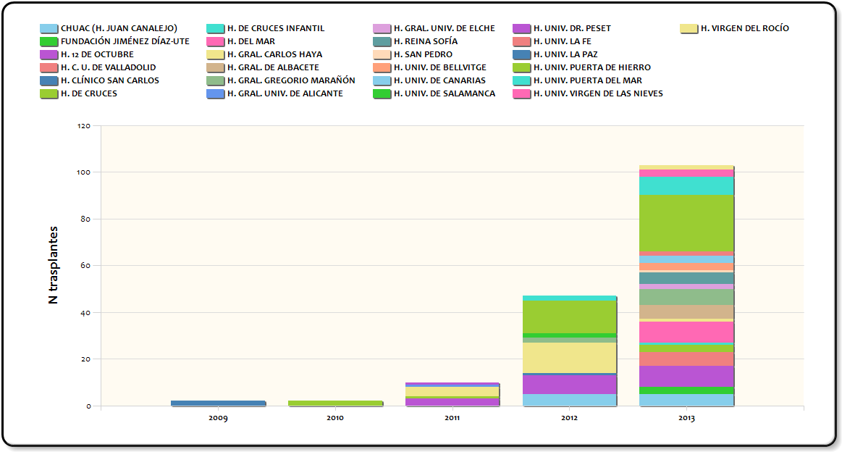
TRANSPLANTS
TYPE III MAASTRICHT DCD
139 KIDNEY TX
22 LIVER TX
3 LUNG TX

Slide 21
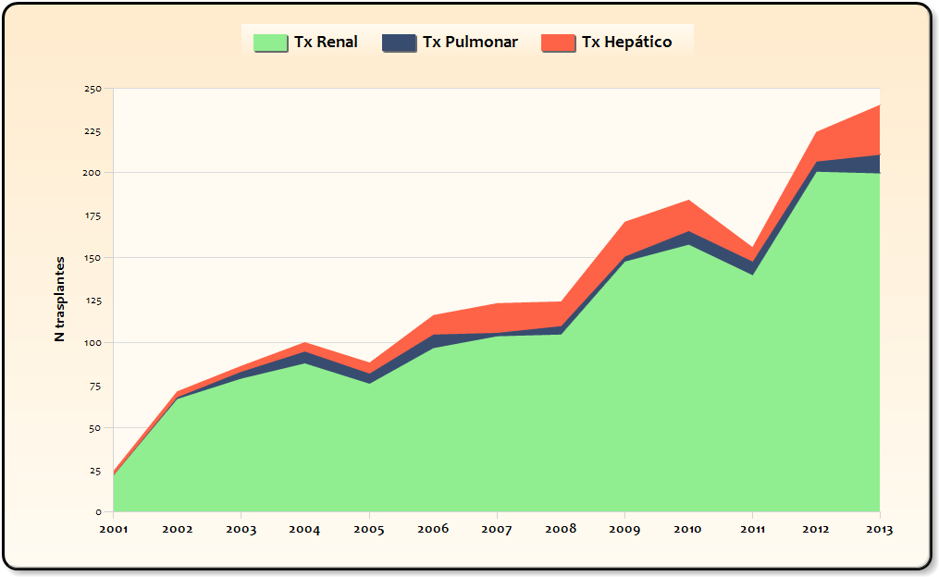
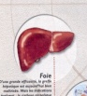
DCD TRANSPLANTS IN SPAIN
1.484
153
69

Slide 22
Brain Death optimization
Living donation
Transmissible diseases
- Neoplasias
Infections
Donation in minorities
Donor Pool
Other pathologies:
HTA. DM
Intoxications
Rare diseases…
Donation after circulatory death
Old donors
Special surgical techniques (liver split and domino. double kidney)
Expanded criteria
Non standard risk donors

Slide 23
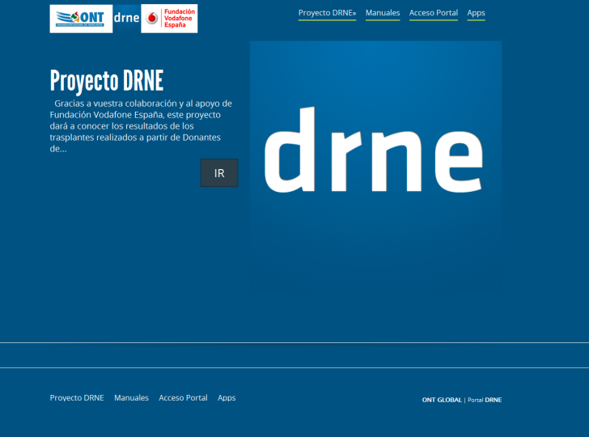


NON STANDARD RISK DONOR (DRNE) PROJECT
Donors with an increased risk of donor related disease in the recipient, assumed before transplantation.
Utilization NSRD
Follow-up recipients
Non Standard Risk Donors

Slide 24
Neoplasias:
Neoplasia maligna activa o antecedente
Infecciones:
  Infecciones SNC
  TBC
  Enf. Emergentes
  Bacteriemias
  Endocarditis
6-12-24 meses
3 meses
Tóxicos:
  Cocaína
  Éxtasis
  Hidrocarburos
  Setas
  Insecticidas organofosforados
  Etilengilcol
  Metanol
  Raticidas
  Otros. Especificar
3 meses
DRNE
Otras:
  Sdm. Mieloproliferativo
  Esclerosis Lateral Amiotrófica
  Lupus Eritematoso
  Esclerosis Múltiple
  Otros. Especificar
12-24 meses
Non Standard Risk Donors

Slide 25
Brain Death optimization
Living donation
Transmissible diseases
- Neoplasias
Infections
Donation in minorities
Donor Pool
Other pathologies:
HTA. DM
Intoxications
Rare diseases…
Donation after circulatory death
Old donors
Special surgical techniques (liver split and domino. double kidney)
Expanded criteria
Non standard risk donors

Slide 26
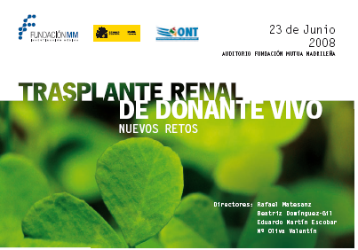
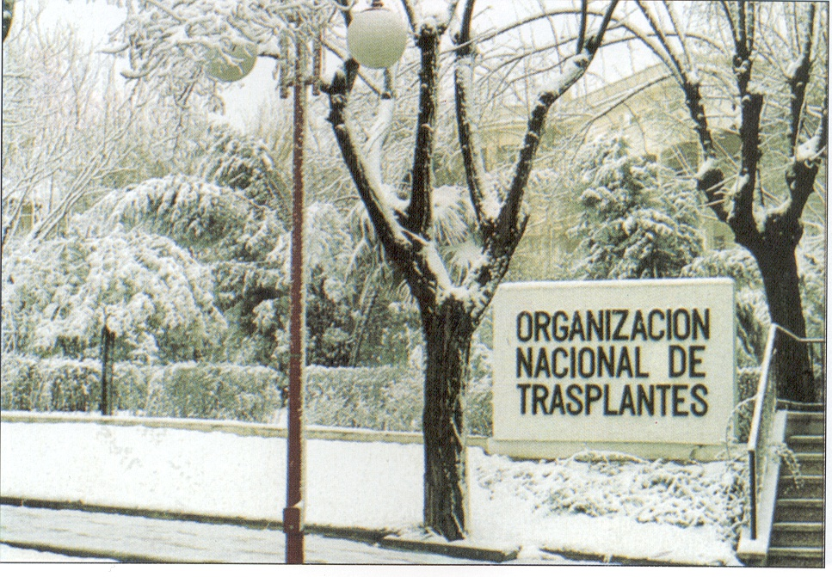
Living Donation
Information program to patients
Information and training professionals
Expand living donors pool: Crossover-Donor Kidney program

Slide 27
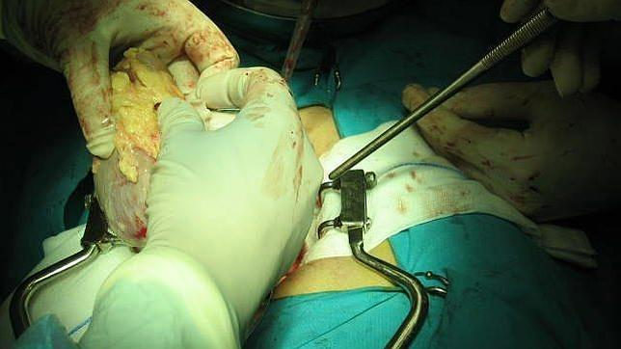
Living Donation
LIVING DONOR KIDNEY TRANSPLANTS
OBJECTIVE: > 10-15%
KIDNEY TRASPLANTS
15%
X 2
X 10

Slide 28

Living Donation
KIDNEY TX EVOLUTION IN SPAIN ACCODING TO DONOR TYPE
DCD
LIVING
BRAIN DEATH

Slide 29
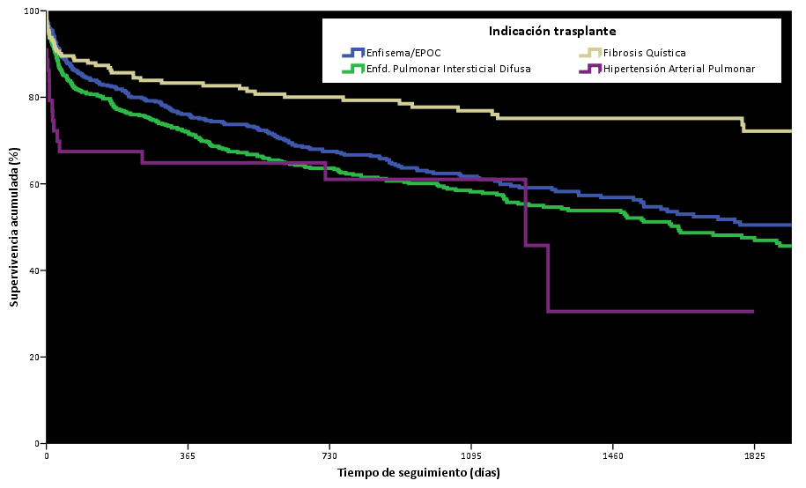
TRASPLANTE PULMONAR ADULTO
Supervivencia Kaplan-Meier por principales indicaciones
(Trasplantes: Enero 2006– Diciembre 2013)
p <0,001
Media edad 33 años (DE 14)
Comparación de supervivencias (p)
Indic tx | Enfis | EPID | FQ | HAP
Enfis | - | 0,114 | <0,001 | 0,106
EPID | 0,114 | - | <0,001 | 0,303
FQ | <0,001 | <0,001 | - | <0,001
HAP | 0,106 | 0,303 | <0,001 | -
54% MUJERES
 | 1 año | 3 años | 5 años
Fibrosis Quística (N=194) | 83,3 (N=133) | 76,9 (N=90) | 72,2 (N=48)
Enfis: Enfisema/EPOC; EPID: Enfd. Pulmonar Intersticial Difusa; FQ: Fibrosis Quística; HAP: Hipertensión Arterial Pulmonar
Notes:
11% tx adultos son por fq

Slide 30
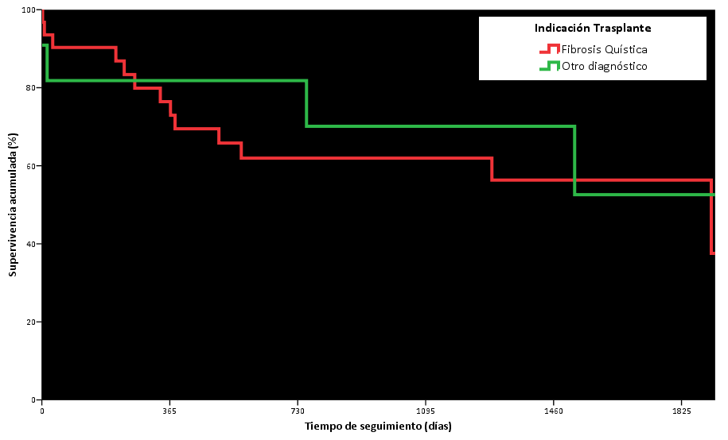

TRASPLANTE PULMONAR PEDIÁTRICO
Supervivencia Kaplan-Meier por indicación de trasplante
(Trasplantes: Enero 2006– Diciembre 2013)
p= 0,658
Media edad 13 años (DE 2)
48% MUJERES
% Supervivencia (N a riesgo)
 | 3 meses | 1 año | 3 años
Fibrosis quística (N=31) | 90,3 (N=28) | 76,4 (N=22) | 62,0 (N=12)
Otro diagnóstico (N=10) | 81,8 (N=9) | 81,8 (N=9) | 70,1 (N=4)
Notes:
63% tx pediatricos son por fq

Slide 31
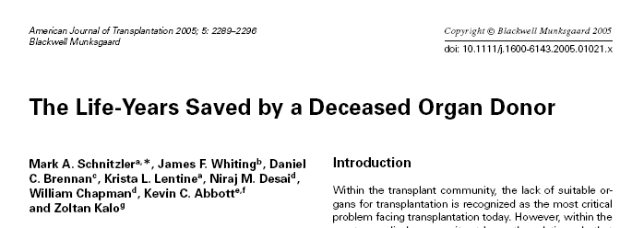
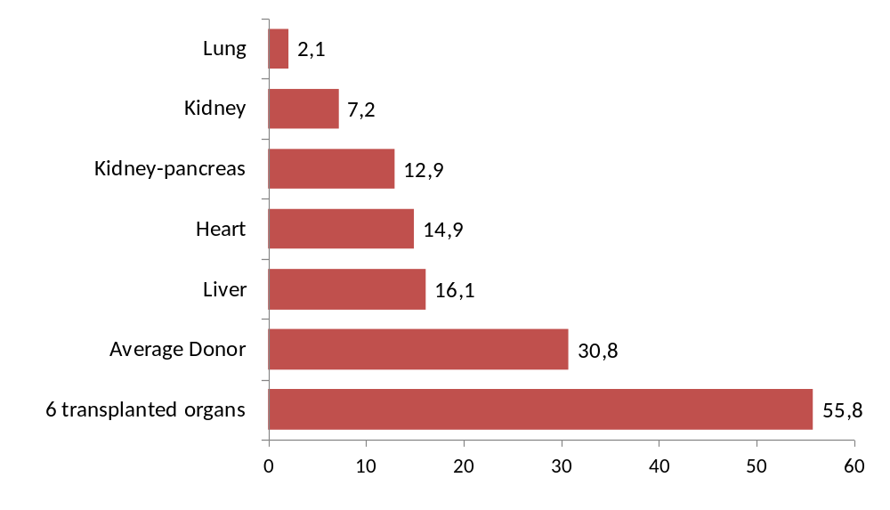

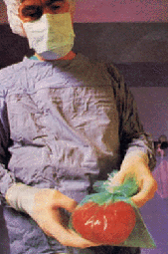
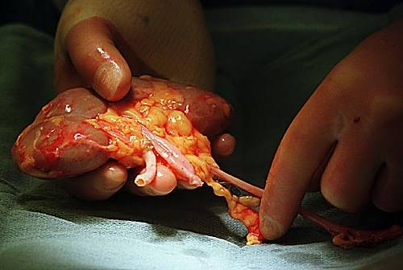
THANK YOU VERY MUCH
ecoll@msssi.es

