Slide 1
Marcatori “patogenetici” predittivi di risposta locale precoce e tardiva
alle terapie in fibrosi cistica
TAVOLA ROTONDA INTERATTIVA
X Congresso Nazionale SIFC
Salerno 20 ottobre – 1 novembre 2014
Moderatore: Luigi Maiuri
European Institute for Research in Cystic Fibrosis (IERFC)
San Raffaele Scientific Institute, Milano
Department of Health Sciences, University of Piemonte Orientale, Novara
Discussant
Natalia Cirilli
Roberto Buzzetti
Donatello Salvatore
Daniela De Stefano
Ancona
Bergamo
Potenza
Milano

Slide 2
Round Table : Introduction
Luigi Maiuri
What we are dealing about
The aim
Searching a proper detector of drug efficacy:
affordable
easy
local (tissue-targeted)
“smart”
The goal
Interactive discussion to promote multicenter collaborative projects
(according to the working plan of the SIFC Basic Research Committee)

Slide 3
Round Table : Introduction
Luigi Maiuri
Firstly, … a glance into the theory
of appropriate approaches:
Methodology issues
Searching a proper detector of drug efficacy:
affordable
easy
local (tissue-targeted)
“smart”
by
Roberto Buzzetti

Slide 4
Round Table : Introduction
Back to clinical application
Luigi Maiuri
What we are dealing about
Detector of drug efficacy
The right marker at the right site at the right time for the right therapy

Slide 5
Round Table : Introduction
Taking into account:
The five “R”
from Astra-Zeneca new agenda to accelerate the pipeline
(Nature Rev Drug Discov 2014: doi: 101038/nrd4309)
Right target
Right patient
Right tissue
Right safety
Right commercial potential

Slide 6
Round Table : Introduction
Our five “R”
(academic research)
Right marker for Right drug (or classes of drugs)
Right tissue: the R marker of local response at the main site of pathology (dependent on the type of drug)
Right target:the “smart” R marker at the R tissue
(a pathogenic marker which addresses the pathogenic pathways supposed to be targeted by the drug)
Right predictor of potential drug efficacy before therapy
IN THE
Right patient
Test of putative individual patient’s responsiveness to a given treatment
(personalized medicine)

Slide 7
The first“R”
Right marker for Right drug
(or classes of drugs)
(The first R depends on the primary outcome of efficacy of the tested drug)
Example A
Drugs aiming at modulating CFTR function
(correctors, potentiators, others … = CFTR modulators)
The primary outcome MUST BE CFTR function
Secondary outcomes:
markers of events downstream to CFTR function
(supposed to be modified BECAUSE OF the rescue of CFTR function)
CFTR function as marker of efficacy: where?
a) Sweat chloride levels: surrogate (and easy) marker of CFTR function
b) Test of CFTR function at the main site of pathology (airways, intestine)
at the right tissue
(our second R)

Slide 8
The first“R”
Right marker for Right drug
(or classes of drugs)
(The first R depends on the primary outcome of efficacy of the tested drug)
Example B
Drugs aiming at controlling
inflammation
(anti-inflammatory)
The primary outcome should be the reduction of signs of inflammation
where?
a) Peripheral: outside our goal
b) Local: at the main site of pathology
at the right tissue
(our second R)

Slide 9
The second“R”
Right marker at the Right tissue
(main site of pathology and main target of the drug)
A window on the lung
Bronchial tissue: conceptually ideal BUT not affordable
“surrogate” : sputum (cytokines, cell counts, microbiology, etc.)
Problem: not ideal to easily monitor CFTR function
Nasal: affordable for both CFTR function and inflammation
NPD: only for function.
Ideal, but difficult standardization
and expensive (instruments)
Brushing: analysis of FRESHLY isolated
brushed nasal cells
Easy, well tolerated, approved by the Ethical committee
Chance of repeated measurements during treatment
Useful for both CFTR function and signs of inflammation
We need tissue to address ALL 5 Rs

Slide 10
The second“R”
Right marker at the Right tissue
(main site of pathology and main target of the drug)
A window on the intestine
Rectal mucosa
RPD : as for NPD in airways
Rectal biopsy : very useful (and easy)
BUT can not be repeated frequently (for ethical reasons)
Rectal brushing : a potential interesting tool to be exploited
We need tissue to address ALL 5 Rs

Slide 11
The third“R”
the “smart” (pathogenic) R marker at the R tissue
(main site of pathology and main target of the drug)
A need resulting from a “scientific MUST” is that pre-clinical data are required
to provide the rationale and proof-of-concept of a treatment
before proceeding to human trials
When administered to patients,
a drug must impact on the pathogenic mechanisms
through which it works in preclinical models
and
on which it has been designed
This can reduce the risk of treatments BY CHANCE
(serendipity)

Slide 12
The fourth and fifth “Rs”
The ideal detector/marker
should be also useful to
predict the efficacy of a right drug in the right patient
(when tested ex-vivo in patient’s samples before in vivo therapy)
(we put the compound (short incubation) directly in contact with the tissue and analyze the same markers that we will use for the analysis after treatment in vivo)
We can:
test the individual patient’s responsiveness to the treatment
design a personalized approach to therapy

Slide 13
Rationale for the use of nasal brushing in monitoring (and predicting) drug efficacy
(as part of a translational research approach)
From basic research
T R A N S L A T I O N
Reverse
translation
To patients

Slide 14
Nasal brushing within the rules of translation
Both human and mouse:
providing rationale and mechanisms
Cell medicine
Mouse medicine
Validating in vivo putative drug candidates
Transferring cell and mouse medicine
to human applications
T R A N S L A T I O N
Primary human cell medicine
Also useful to predict individual responsiveness to treatment
(if they belong to the patients before treatment)
Reverse
translation
Human medicine
Monitor treatment efficacy in patient’s samples
For Translational and Reverse Translation the primary cells :
Should be freshly collected and analysed (without manipulations)
Should belong to the patient enrolled for treatment
Should be collected several times during treatment

Slide 15
Dream or reality ?
Only research or clinical application ?
Yes, we can use it in clinical practice

Slide 16
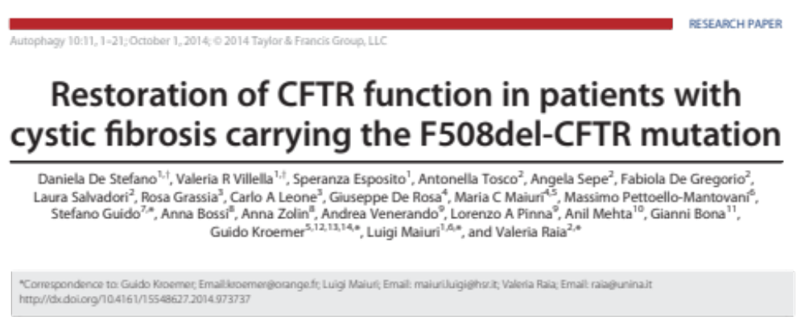
Validation of nasal brushing in monitoring (and predicting) drug efficacy in F508del-CFTR homozygous patients
Aim
Rescue of F508del-CFTR function through restoring autophagy by a treatment (EudraCT #2013-001258-82)
proved to be effective in pre-clinical models of disease (cells, in vivo mouse and primary human cells)

Slide 17
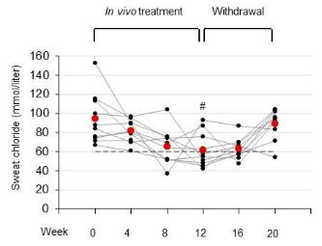
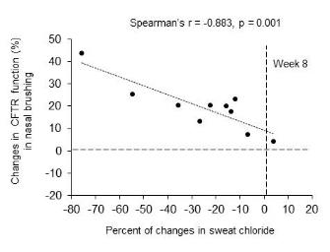
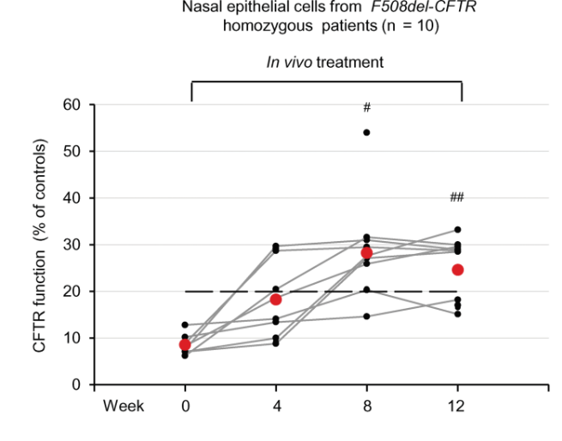
Right marker on Right tissue for Right drug
Sweat: reduced chloride levels
The treatment restores
F508del-CFTR function
Sweat
Nasal brushing
Nasal brushing: increase of CFTR function
Inverse correlation p=0.001
De Stefano D et al, Autophagy, in press
DOI: 10.4161/15548627.2014.973737

Slide 18
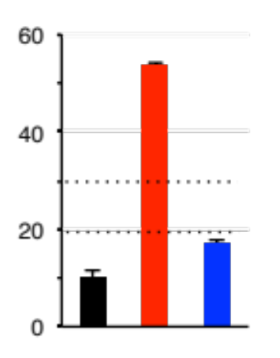
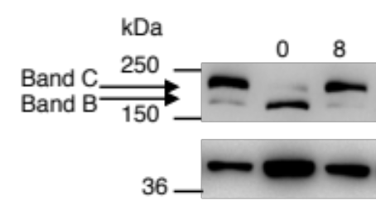
Right marker on Right tissue for Right drug
Monitoring CFTR function in nasal brushing:
internal validation of the assessment of CFTR function
Effect of treatment
Increase of CFTR function
Rescue of CFTR Band C
Rate of halide efflux by SPQ fluorescence
Biochemical assessment of CFTR protein
Patient 10
CFTR function
(% of non-CF controls)
Non-CF Control
Before treatment
Patient 10
weeks of treatment
After 8 weeks of
in vivo treatment
CFTR
β-actin
Representative of treated patients
Representative of treated patients
De Stefano D et al, Autophagy, in press
DOI: 10.4161/15548627.2014.973737

Slide 19
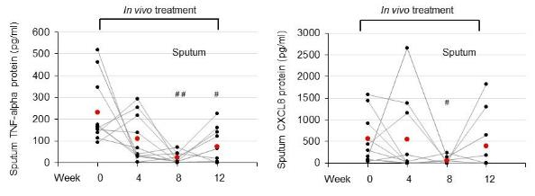
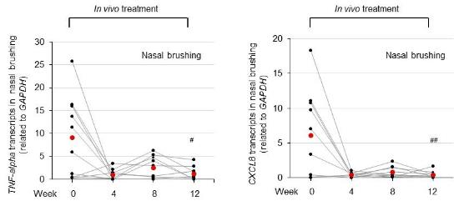
Right marker on Right tissue for Right drug
Nasal brushing as a window on the lung
The treatment reduces lung inflammation
Sputum
Reduced TNFα and IL-8 levels
Nasal brushing
Reduced TNFα and IL-8 levels
De Stefano D et al, Autophagy, in press
DOI: 10.4161/15548627.2014.973737

Slide 20
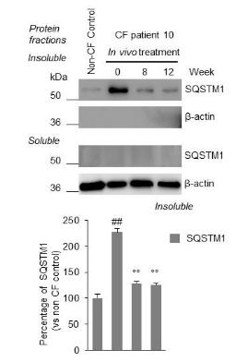
Right “smart” marker on Right tissue for Right drug
Nasal brushing as “smart” detector
The treatment rescues F508del-CFTR function
VIA restoring autophagy
Nasal brushing
Rescue of autophagy
(reduction of p62 protein levels)
after treatment in vivo
Representative of treated patients
De Stefano D et al, Autophagy, in press
DOI: 10.4161/15548627.2014.973737

Slide 21
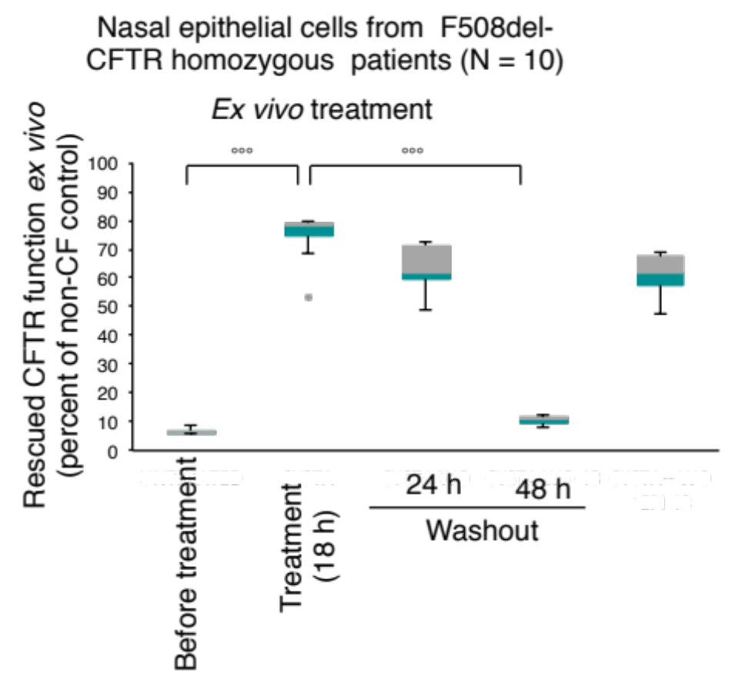
Nasal brushing as PREDICTOR of drug efficacy
A useful tool for a personalized approach to therapy
Ex-vivo testing of individual patient’s responsiveness to a proposed treatment
Predicting responsiveness
Right Predictor
Monitoring in vivo therapy
De Stefano D et al, Autophagy, in press
DOI: 10.4161/15548627.2014.973737

Slide 22
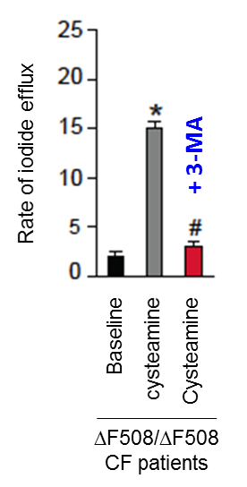
Nasal brushing as PREDICTOR of drug efficacy
A useful tool for a personalized approach to therapy
Rescue of CFTR function
ex vivo
VIA restoration of autophagy
Ex-vivo testing of individual patient’s responsiveness to a proposed treatment
Autophagy is required
Right «smart» Predictor
Restoration of autophagy :
a new «smart» marker ?
De Stefano D et al, Autophagy, in press
DOI: 10.4161/15548627.2014.973737

Slide 23
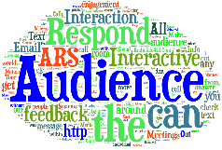

Proposed topics for discussion
Finding an “affordable” Right Detector of efficacy for a given treatment
Finding an “affordable” Right Predictor of individual patient’s responsiveness
Q1: Finding a proper
Tissue-targeted Detector
(and Predictor)
of drug efficacy
Q2: Finding a proper
“smart” marker
of drug efficacy
Natalia Cirilli
Roberto Buzzetti
Donatello Salvatore
Daniela De Stefano

